Slide 1


May Connect Metrics
Clarence Lau

Slide 2
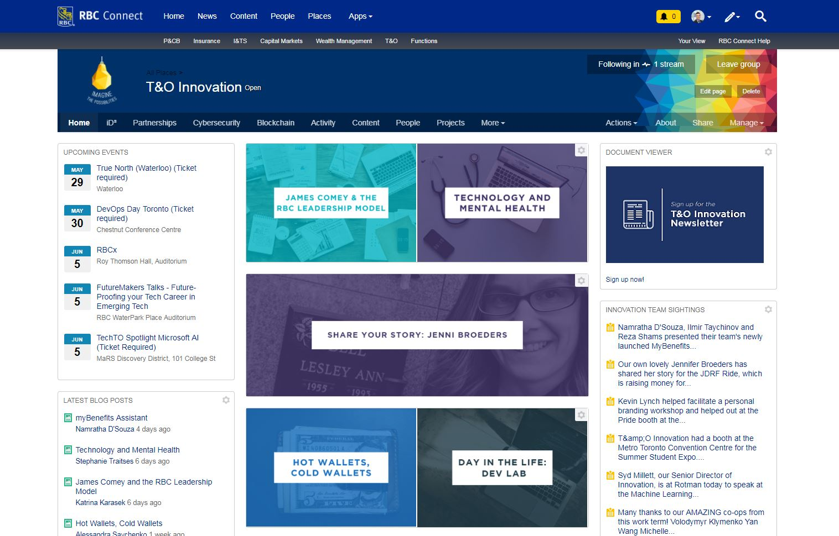
Innovation Homepage
April 3, 2018:
894 Followers
May 29, 2018
950 Followers
6.26% Increase

Slide 3
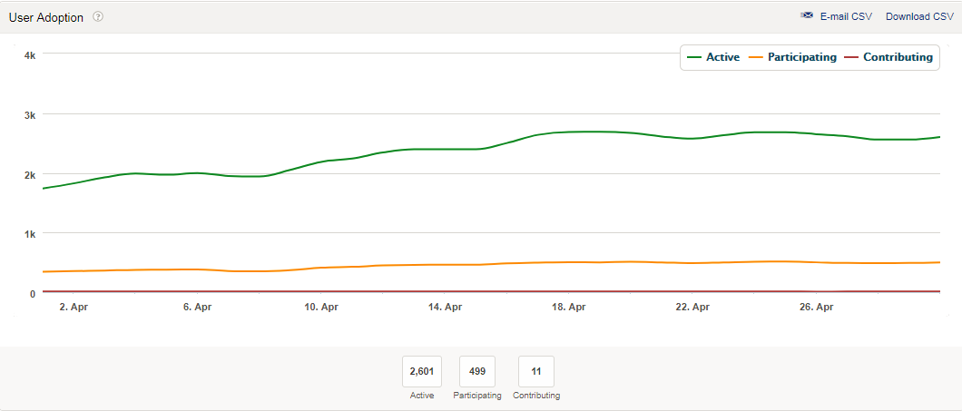
User Adoption: May
Stats
2546 Active Users
499 Participating Users
11 Contributing Users
Rates
Engagement Rate: 19.60%
Contribution Rate: 0.43%
Notes:
Graph will be changed for end of month (May 31)

Slide 4
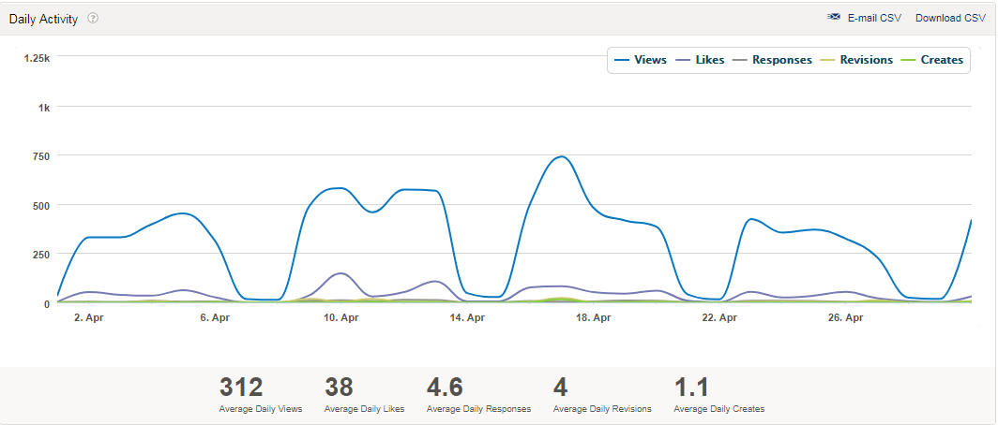
Daily Activity: May
Stats
9164 Views
1126 Likes
153 Responses
26 Creates
Rates
Engagement Rate: 16.00%
Notes:
Graph will be changed for end of month (May 31)

Slide 5



Successes
More people creating posts
More Diverse Views
Mental Health Month Blog Posts

Slide 6



Areas of Improvement
The rebrand is coming soon!
Less overall active users
.
Less featured posts on homepage

Slide 7
The Most Popular Innovation Employee on Connect in May was…

Slide 8


…Devon!

Slide 9
Top May Posts on Connect
(We’ve always got more work to do)
1. Take 10 Breaths | Lisa Helm | 1,459 views
2. Should you “risk” your career on a startup or an established company? | Lisa Helm | 1,410 views
3. The State of Cryptocurrency | Clarence Lau | 1,080 views
4. Are cryptocurrency and blockchain the same thing? | Devon Lacombe | 770 views
5. Will Cryptocurrencies Replace Fiat Currencies | Lisa Helm | 241 views
Notes:
table

Slide 10
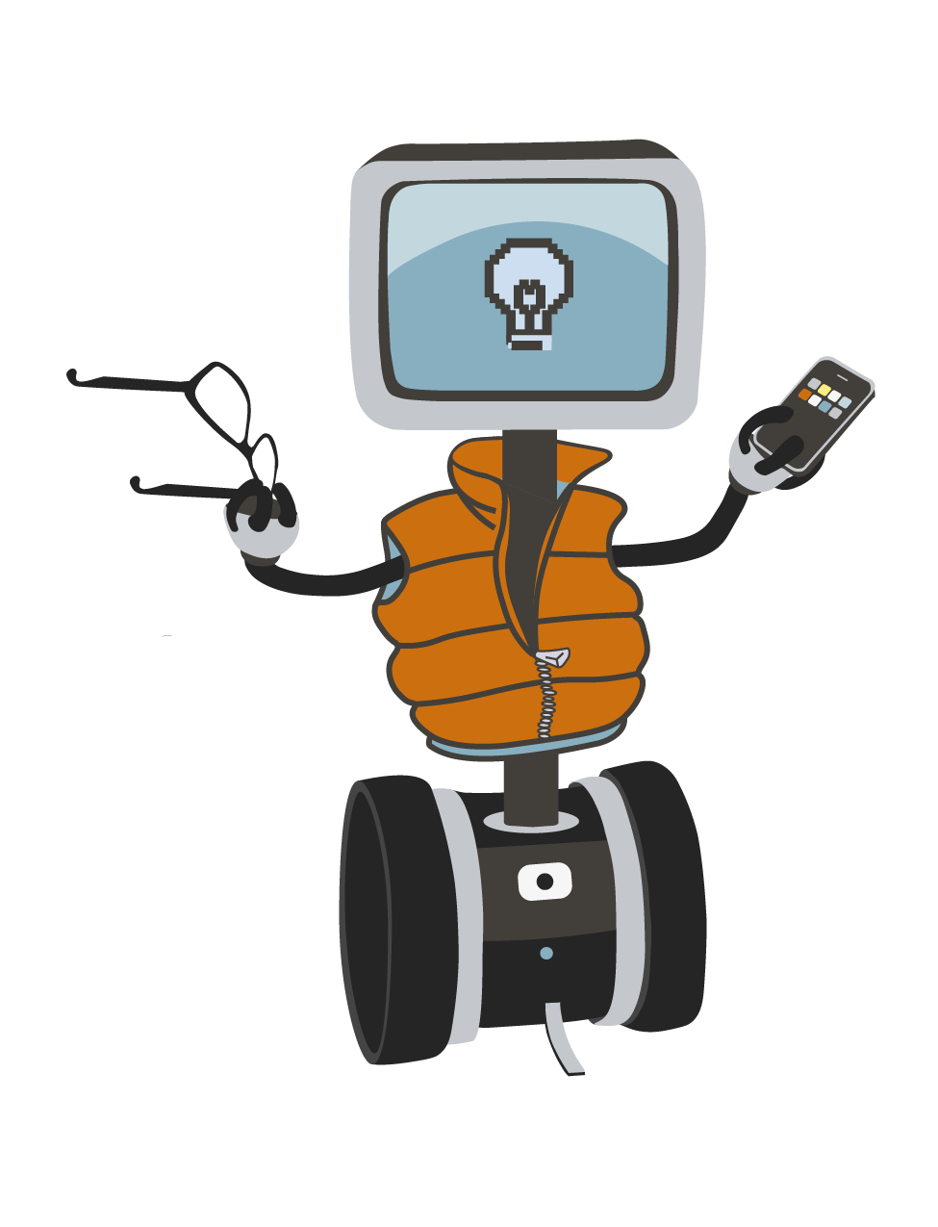
Questions?
If you’d like to contribute, talk to Lisa or Clarence
Thanks for Listening!
Notes:
If people want to contribute – TALK TO MYSELF OR LISA, we can put it into the content calendar

